Slide 1
Design of lacing, Battering and Column bases
Codal Requirement
IS 800:2007 Steel table
Example 1 Design a build up column to carry an axial load of 666.67kN which is 5.5m long hinged at both ends. Design the associated lacing system also. Use steel of grade Fe410 and bolts of grade 4.6. only available section is channel section. Explain all possible arrangement of channel section.
Solution : Design load is 666.67KN , factored load = 1.5*666.67 = 1000KN
For Fe 410, f_{u} = 410 N/mm², f_{y =} 250N/mm²
Let bolts of grade 4.6 are used and thus f_{ub=}400N/mm²
Factor od safety for angle material ¥_{mo} = 1.10
Factor od safety for angle material ¥_{mb} = 1.25
For preliminary design, let design compressive stress, f_{cd}=150N/mm²
Cross section area required A=P/ f_{cd, where} P = 1000kN
= 1000*1000/150 = 6666.67mm²

Slide 2
Designati on | Weight per Mete (w) | Sectional Area (a) | Depth of Section (h) | Width of flange (b) | Thickness of Flange (t_{f}) | Thicknes s of Web (t_{w}) | Centre of Gravity Cyy | Ixx cm4 | Iyy cm4 | Raddi of Gyration rxx | Raddi of Gyration ryy | Modulli of Section Zxx | Modulli of Section Zyy | Connection Details |  |  |  |  |  | Maximum size of Flange Rivet | Designati on
 | kg | cm² | mm | mm | mm | mm | cm |  |  | cm | cm | cm³ | cm³ | h₁ | h2 | b1/2 | C | g | g₁ | mm
 |  |  |  |  |  |  |  |  |  |  |  |  |  | mm | mm | mm | mm | mm | (min) mm
ISMC 75 | 6.8 | 8.67 | 75 | 40 | 7.3 | 4.4 | 1.31 | 76 | 12.6 | 2.96 | 1.21 | 20.3 | 4.7 | 41.4 | 16.8 | 17.8 | 5.9 | 21 | 50 | 12 | ISMC 75
ISMC 100 | 9.2 | 11.7 | 100 | 50 | 7.5 | 4.7 | 1.53 | 186.7 | 25.9 | 4 | 1.49 | 37.3 | 7.5 | 64 | 18 | 22.7 | 6.2 | 28 | 50 | 16 | ISMC 100
ISMC 125 | 12.7 | 16.19 | 125 | 65 | 8.1 | 5 | 1.94 | 416.4 | 59.9 | 5.07 | 1.92 | 66.6 | 13.1 | 85.4 | 19.8 | 30 | 6.5 | 35 | 55 | 22 | ISMC 125
ISMC 150 | 16.4 | 20.88 | 150 | 75 | 9 | 5.4 | 2.22 | 779.4 | 102.3 | 6.11 | 2.21 | 103.9 | 19.4 | 106.7 | 21.7 | 34.8 | 6.9 | 40 | 55 | 25 | ISMC 150
ISMC 175 | 19.1 | 24.38 | 175 | 75 | 10.2 | 5.7 | 2.2 | 1223.3 | 121 | 7.08 | 2.23 | 139.8 | 22.8 | 128.4 | 23.3 | 34.7 | 7.2 | 40 | 55 | 25 | ISMC 175
ISMC 200 | 22.1 | 28.21 | 200 | 75 | 11.4 | 6.1 | 2.17 | 1819.3 | 140.4 | 8.03 | 2.23 | 181.9 | 26.3 | 150.2 | 24.9 | 34.5 | 7.6 | 40 | 60 | 25 | ISMC 200
ISMC 225 | 25.9 | 33.01 | 225 | 80 | 12.4 | 6.4 | 2.3 | 2694.6 | 187.2 | 9.03 | 2.38 | 239.5 | 32.8 | 170.9 | 27.1 | 36.8 | 7.9 | 45 | 60 | 25 | ISMC 225
ISMC 250 | 30.4 | 38.67 | 250 | 80 | 14.1 | 7.1 | 2.3 | 3816.8 | 219.1 | 9.94 | 2.38 | 305.3 | 38.4 | 192.5 | 28.7 | 36.5 | 8.6 | 45 | 65 | 25 | ISMC 250
ISMC 300 | 35.8 | 45.64 | 300 | 90 | 13.6 | 7.6 | 2.36 | 6362.8 | 310.8 | 11.81 | 2.61 | 424.2 | 46.8 | 240.7 | 29.6 | 41.2 | 9.1 | 50 | 65 | 28 | ISMC 300
ISMC 350 | 42.1 | 53.66 | 350 | 100 | 13.5 | 8.1 | 2.44 | 10008 | 430.6 | 13.66 | 2.83 | 571.9 | 51 | 288.1 | 30.9 | 46 | 9.6 | 60 | 65 | 28 | ISMC 350
ISMC 400 | 49.4 | 62.93 | 400 | 100 | 15.3 | 8.6 | 2.42 | 15082.8 | 504.8 | 15.48 | 2.83 | 754.1 | 66.6 | 332.8 | 33.6 | 45.7 | 10.1 | 60 | 70 | 28 | ISMC 400
Try ISMC 250@298.2N/m
Thus, area provided by 2 ISMC 250 = 2*3867 = 7734mm² > 6666.67mm²

Slide 3
The advantage of build up column is that least radius of gyration can be increased so that is lest radios of gyration can be made more at least equal to r_{zz} i.e.
r_{min} =r_{zz} this is done by adjusting spacing between the sections.
Effective length = kL = 1*5.5 = 5.5m
For effective slenderness ratio
(kL/r) _{e} = 58.09 and f_{y} 250N/mm² and for buckling curve “C”
Design compressive stress (f_{cd}) = 170.85 N/mm²
Design compressive strength (P_{cd}) = f_{cd*}A = 170.85*(2*3867) N = 1321.37 KN
1321.37 kN > 1000kN
Now minimum radius of gyration (ʎ_{min}) = r_{z} | = 99.4mm
Slenderness ration ʎ = kL/ r_{z} = 5500/99.4 | = 55.33
Effective slenderness ratio (ʎ_{e}) = 1.05*55.33 | = 58.09 < 180 …. Ok
ISMC 250@298.2N/m | is ……………………………………………………………. | over safe

Slide 4
Buckling class C table for f_{cd} value
Thus, Try ISMC 225
For effective slenderness ratio
(kL/r)_{e} = 63.95 and f_{y} 250N/mm² and for buckling curve “C”
Design compressive stress (f_{cd}) = 161.67N/mm²
Design compressive strength (P_{cd}) = f_{cd*}A = 161.67*(2*3301) N = 1067.37KN
1067.37 kN > 1000kN … ok
Thus, ISMC 225 is safe
kL/r | 10 | 20 | 30 | 40 | 50 | 60 | 70 | 80 | 90 | 100 | 110 | 120 | 130 | 140 | 150 | 160 | 170 | 180 | 190 | 200 | 210 | 220 | 230 | 240 | 250
F_{cd} | 227 | 224 | 211 | 198 | 183 | 168 | 152 | 136 | 121 | 107 | 94.6 | 83.7 | 74.3 | 66.2 | 59.2 | 53.3 | 48.1 | 43.6 | 39.7 | 36.3 | 33.3 | 30.6 | 28.3 | 26.2 | 24.3
f | 0.3 | 1.3 | 1.3 | 1.5 | 1.5 | 1.6 | 1.6 | 1.5 | 1.4 | 1.24 | 1.09 | 0.94 | 0.81 | 0.7 | 0.59 | 0.52 | 0.45 | 0.39 | 0.34 | 0.3 | 0.27 | 0.24 | 0.21 | 0.19
area provided by 2 ISMC 225 = 2*3301 | = 6602 mm²
Now minimum radius of gyration (ʎ_{min}) | = r_{z} = 90.3mm
Slenderness ration ʎ = kL/ r_{z} | = 5500/90.3 = 60.90
Effective slenderness ratio (ʎ_{e}) | = 1.05*60.90 = 63.95 < 180 …. Ok

Slide 5
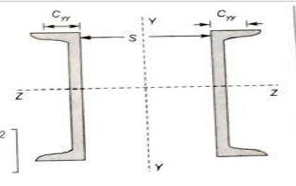
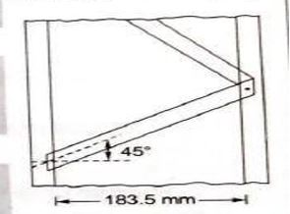
A) Arrangement 1 – Channels are placed back to back
The channels are so spaced that
M.O.I. _{z} = M.O.I. _{y}
2I_{z} = 2(I_{y} + A(S/2 + C_{yy})²)
2*2694.6*10000 = 2(187.2*10000 + 3301 (S/2 + 23.6)²)
S = 120.47 mm = 120.47 mm
Thus place channels back to back at a spacing of 120.47 mm
Design of lacings
Let lacing are inclined at 45 deg with the horizontal
Thus length of channel between lacings = (120.47 +45+45)cot45 * 2 = 420.94 mm
Therefore, Slenderness ratio of portion of channel between lacings
= 420.94/r_{y} = 440.95/23.8 = 18.3 < 50 (OK)
Also, 0.7 (kL/r)_{e} = 0.7 x 63.95 = 44.76 > 18.52 (OK)
Design shear for lacing (V0 = 2.5% of axial load = 2.5/100 x 1000 = 25 KN
Therefore, shear in each plane = V/N = 2.5/2 = 12.5 KN
Therefore, compressive force in the lacing bars = (V/N) *cosec (45) = 17.68 KN
120.47

Slide 6
Section of lacing flat
Using 16 mm diameter bolts, minimum width of lacing flat required = 3 x 16 = 48 mm = say 55 mm
Thus minimum thickness of lacing flat
= 1/40 ( Distance between the inner end bolts)
= 1/40 ( 120.47 + 45 +45)cosec 45
= 5.26 mm = say 8 mm
Therefore provide lacing flat of size 55 x 8 mm( 55 ISF 8mm)
Minimum radius of gyration,
R = t/sqrt(12) = 8/sqrt(12) = 2.30
Length of lacing is 420.94 and consider both end fixed, so K = 0.5
Slenderness ratio, KL/r = 210.47 cosec 45/2.30 = 129 < 145 OK
F_{cd =} 75.24, P_{cd} = 75.24*55*8 = 33.10KN > 17.68
Therefore provide lacing flat of size 55 x 12 mm( 55 ISF 12 mm)
Minimum radius of gyration,
R = t/sqrt(12) = 12/sqrt(12) = 3.64
For KL/r = 107.16, f_{y} = 250 N/mm² and for buckling curve c
Design compressive stress (f_{cd}) = 98.11 N/mm²
Therefore, Design compressive strength (P_{cd}) = f_{cd} x A
= 98.11 x (55 x 12) N
= 64.7 KN (>17.68 KN)

Slide 7
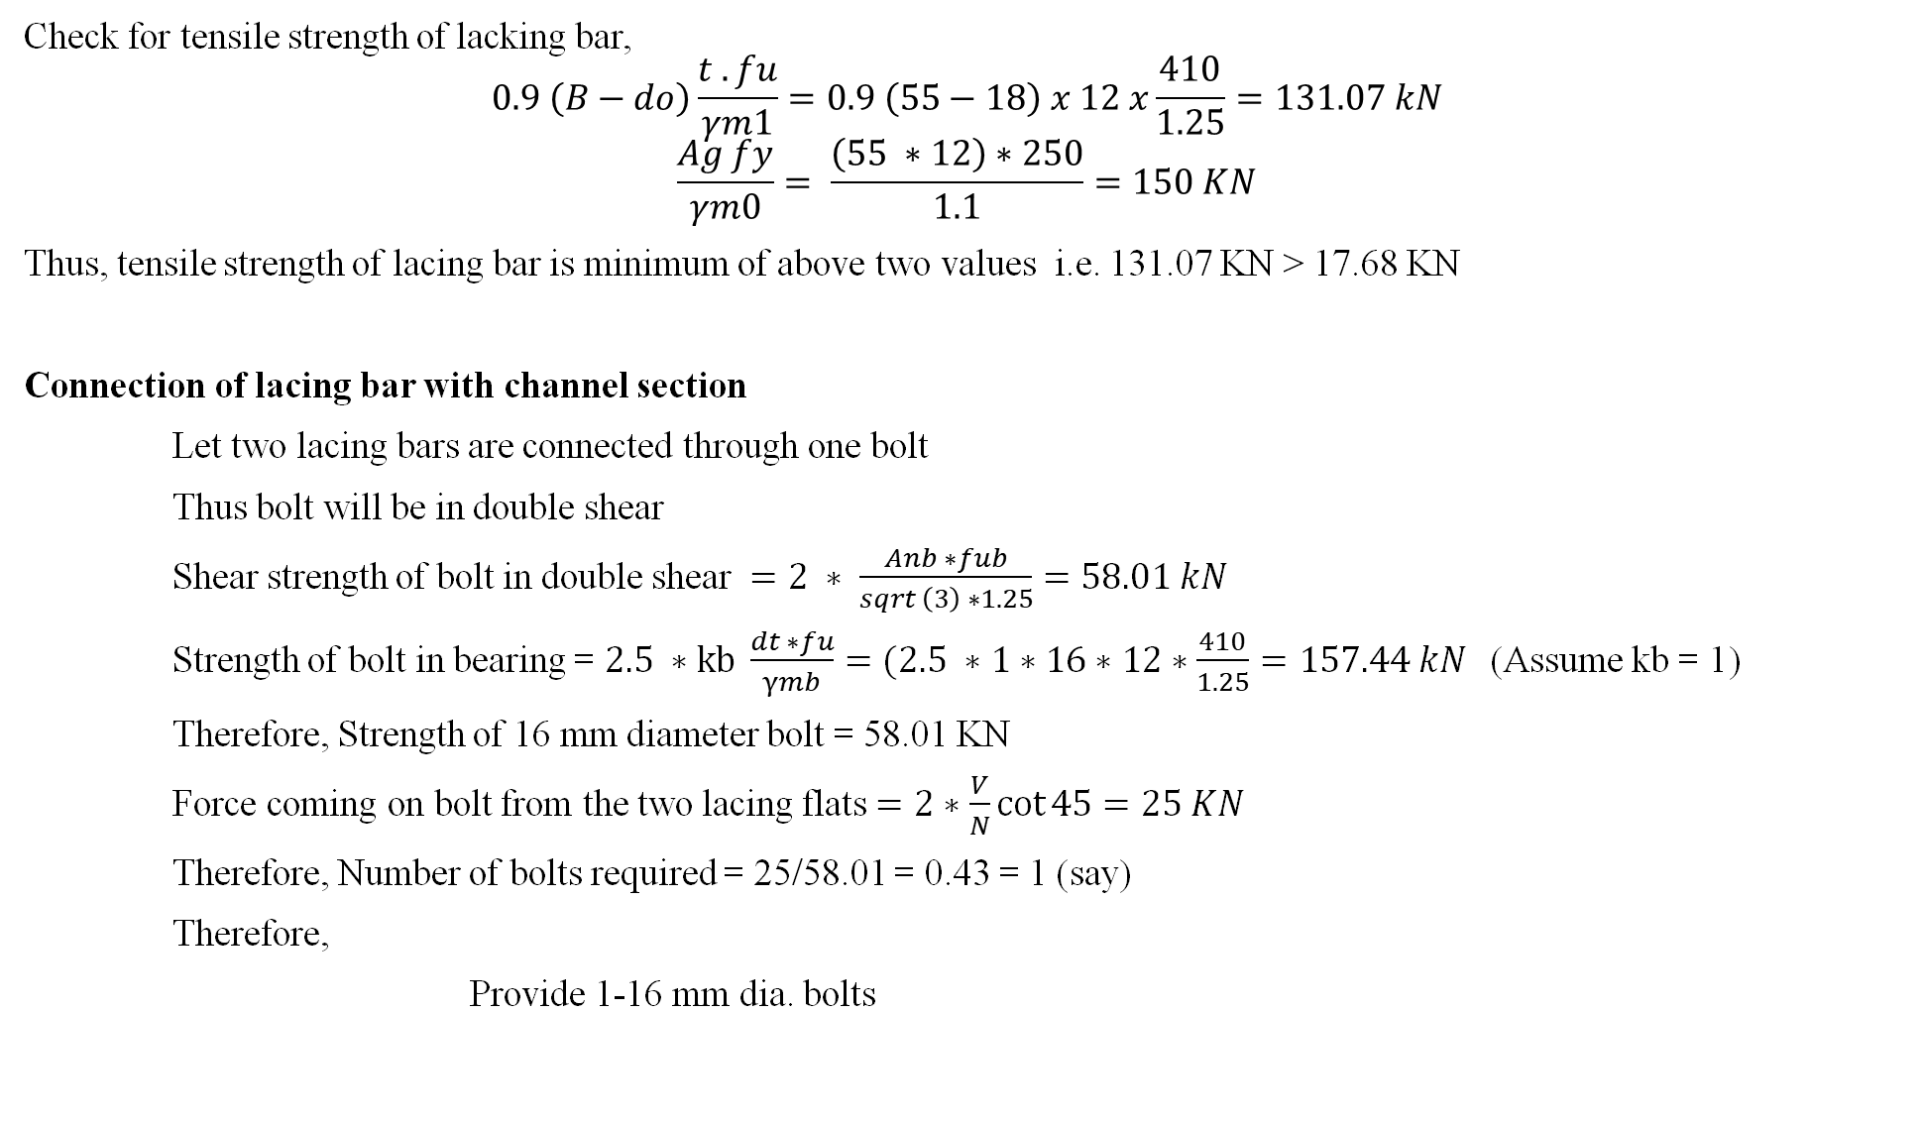
Check for tensile strength of lacking bar,
$$0.9 \left(B−do\right)\frac{t . fu}{γm1}=0.9 \left(55−18\right) x 12 x\frac{410}{1.25}=131.07 kN$$
$$\frac{Ag fy}{γm0}= \frac{\left(55 ∗12\right)∗250}{1.1}=150 KN$$
Thus, tensile strength of lacing bar is minimum of above two values i.e. 131.07 KN > 17.68 KN
Connection of lacing bar with channel section
Let two lacing bars are connected through one bolt
Thus bolt will be in double shear
Shear strength of bolt in double shear $=2 ∗ \frac{Anb ∗fub}{sqrt \left(3\right) ∗1.25}=58.01 kN$
Strength of bolt in bearing = $2.5 ∗kb \frac{dt ∗fu}{γmb}=(2.5 ∗1∗16∗12∗\frac{410}{1.25}=157.44 kN$(Assume kb = 1)
Therefore, Strength of 16 mm diameter bolt = 58.01 KN
Force coming on bolt from the two lacing flats $=2∗\frac{V}{N}\cot{45}=25 KN$
Therefore, Number of bolts required = 25/58.01 = 0.43 = 1 (say)
Therefore,
Provide 1-16 mm dia. bolts

Slide 8
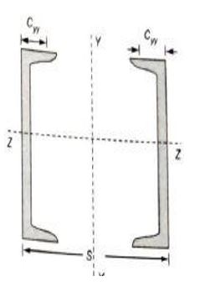
B) Arrangement 2 – Channels are placed face to face
The channels are so spaced that
M.O.I._{z} = M.O.I._{y}
2I_{z} = 2(I_{y} + A(S/2 - C_{yy})²)
2*2694.6*10000 = 2(187.2*10000 + 3301 (S/2 - 23.6)²)
S = 221.50 mm = 221.50 mm
Thus place channels face to face at a spacing of 221.50 mm
Design of lacings
Let lacing are inclined at 45 deg with the horizontal
Thus length of channel between lacings = (221.50 – 45 - 45)cot45 * 2 = 263 mm
Therefore, Slenderness ratio of portion of channel between lacings
= 263/r_{y} = 356/23.8 = 11.05 < 50 (OK)
Also, 0.7 (kL/r)_{e} = 0.7 x 63.95 = 44.765 > 11.05 (OK)
Design shear for lacing (V₀ = 2.5% of axial load = 2.5/100 x 1000 = 25 KN
Therefore, shear in each plane = V/N = 2.5/2 = 12.5 KN
Therefore, compressive force in the lacing bars = V cosec (45)/N = 17.68 KN
221.50

Slide 9
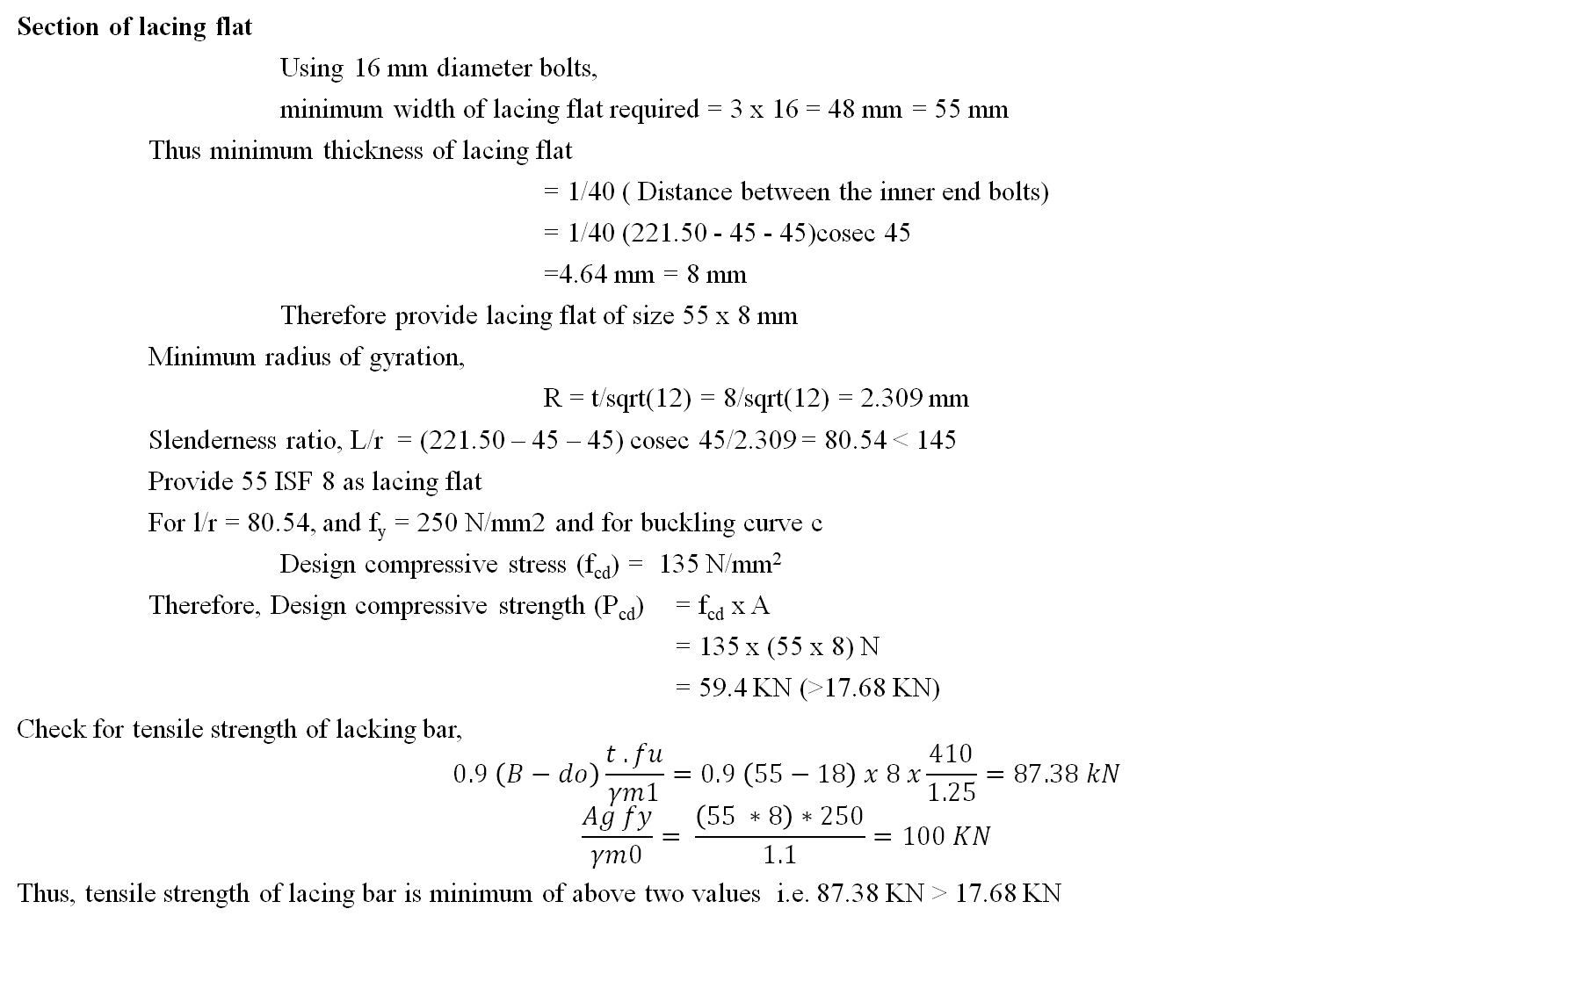
Section of lacing flat
Using 16 mm diameter bolts,
minimum width of lacing flat required = 3 x 16 = 48 mm = 55 mm
Thus minimum thickness of lacing flat
= 1/40 ( Distance between the inner end bolts)
= 1/40 (221.50 - 45 - 45)cosec 45
=4.64 mm = 8 mm
Therefore provide lacing flat of size 55 x 8 mm
Minimum radius of gyration,
R = t/sqrt(12) = 8/sqrt(12) = 2.309 mm
Slenderness ratio, L/r = (221.50 – 45 – 45) cosec 45/2.309 = 80.54 < 145
Provide 55 ISF 8 as lacing flat
For l/r = 80.54, and f_{y} = 250 N/mm2 and for buckling curve c
Design compressive stress (f_{cd}) = 135 N/mm²
Therefore, Design compressive strength (P_{cd}) = f_{cd} x A
= 135 x (55 x 8) N
= 59.4 KN (>17.68 KN)
Check for tensile strength of lacking bar,
$$0.9 \left(B−do\right)\frac{t . fu}{γm1}=0.9 \left(55−18\right) x 8 x\frac{410}{1.25}=87.38 kN$$
$$\frac{Ag fy}{γm0}= \frac{\left(55 ∗8\right)∗250}{1.1}=100 KN$$
Thus, tensile strength of lacing bar is minimum of above two values i.e. 87.38 KN > 17.68 KN

Slide 10
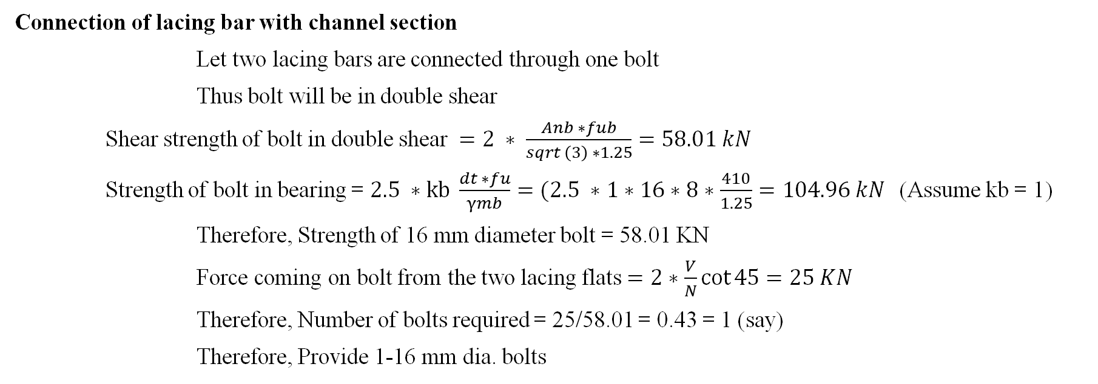
Connection of lacing bar with channel section
Let two lacing bars are connected through one bolt
Thus bolt will be in double shear
Shear strength of bolt in double shear $=2 ∗ \frac{Anb ∗fub}{sqrt \left(3\right) ∗1.25}=58.01 kN$
Strength of bolt in bearing = $2.5 ∗kb \frac{dt ∗fu}{γmb}=(2.5 ∗1∗16∗8∗\frac{410}{1.25}=104.96 kN$(Assume kb = 1)
Therefore, Strength of 16 mm diameter bolt = 58.01 KN
Force coming on bolt from the two lacing flats $=2∗\frac{V}{N}\cot{45}=25 KN$
Therefore, Number of bolts required = 25/58.01 = 0.43 = 1 (say)
Therefore, Provide 1-16 mm dia. bolts

